Slide 1
Portfolio
Sarah Taylor | Content Marketing Leader

Slide 2
Overview
6 years leading content across social, email, video, and influencer campaigns during a period of growth, acquisition, and change
Grew Athletico’s social presence to 87,300+ total followers, including 17% growth from 2024–2025
Engagement-first strategy with a strong emphasis on short-form video
Managed high-volume output (~300 pieces/month) while shifting toward quality over quantity to drive organic engagement

Slide 3








Social Media Accounts Managed
*Buttons are clickable
Notes:
https://www.facebook.com/athleticopt/
https://www.instagram.com/athletico_pt/
https://www.linkedin.com/company/athletico
https://www.pinterest.com/athletico_pt/
https://www.tiktok.com/@athletico_pt
https://x.com/Athletico
https://www.youtube.com/@AthleticoPT
https://www.strava.com/clubs/athleticopt

Slide 4
Supporting social strategy and content at a national, enterprise scale.

Slide 5
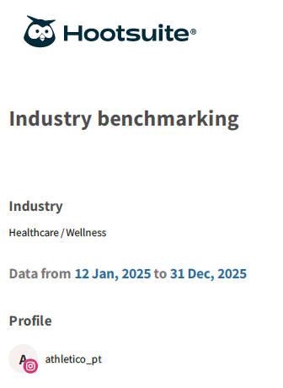
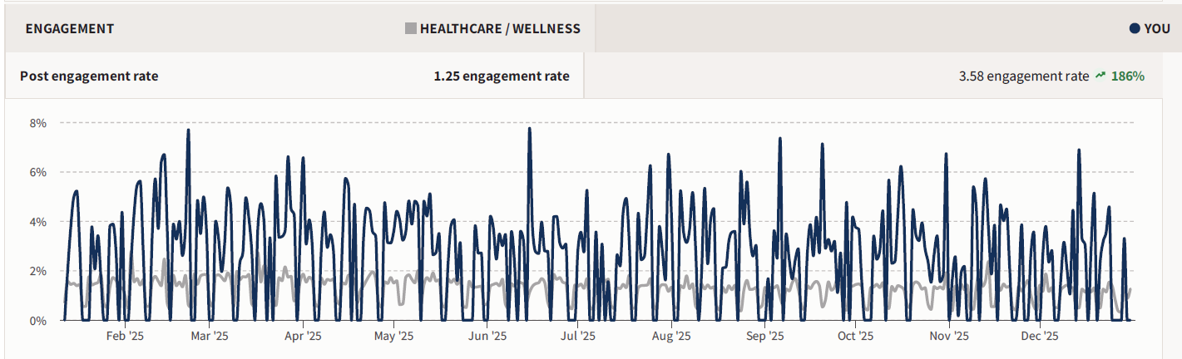
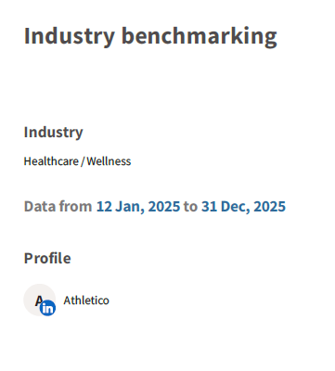
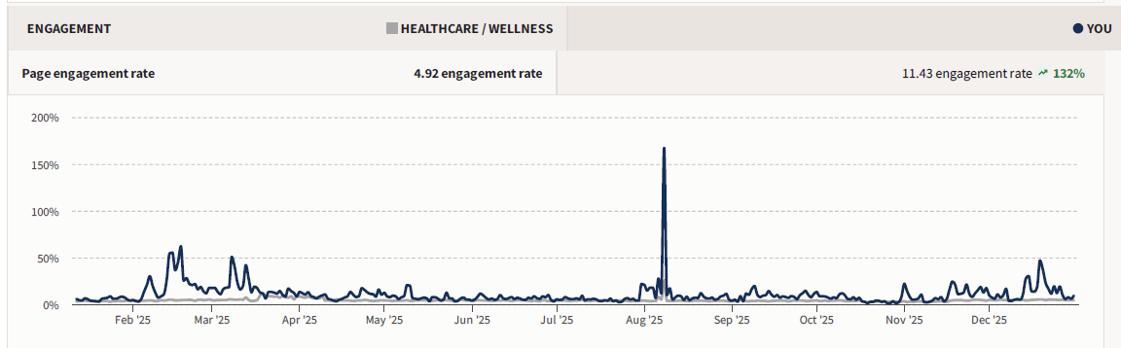
Exceeded Industry Benchmarks – Engagement Rates
Enterprise-scale social management with engagement consistently exceeding industry benchmarks

Slide 6
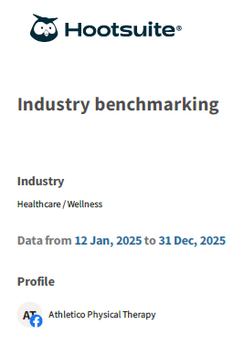
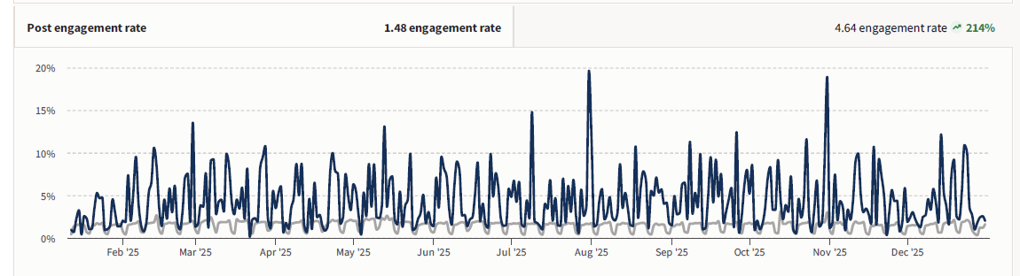
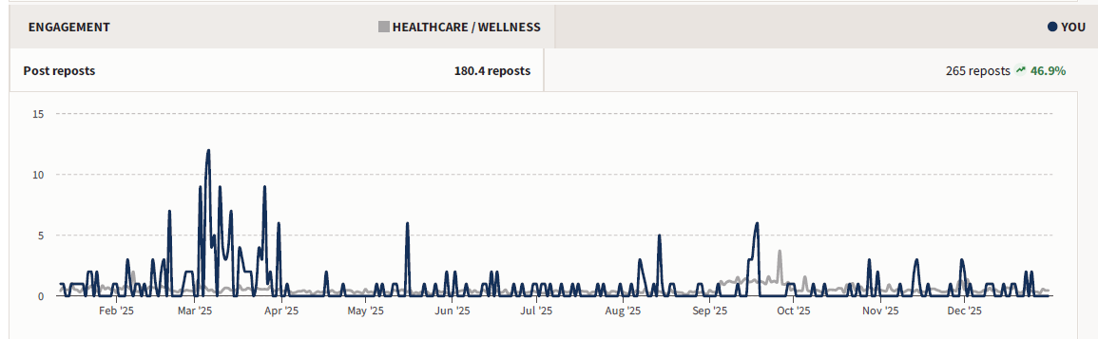
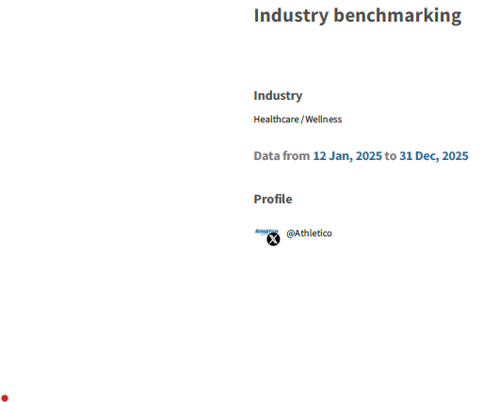
Exceeded Industry Benchmarks – Engagement Rates

Slide 7
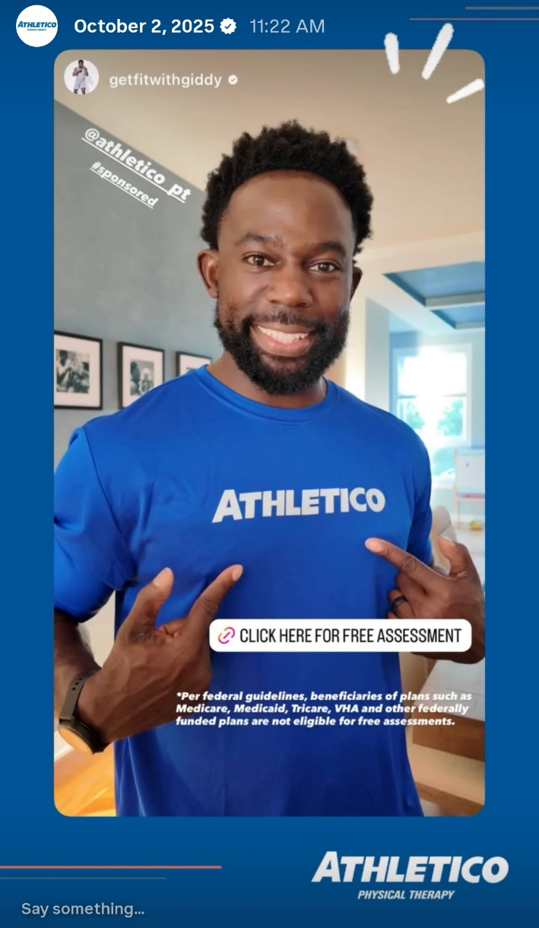
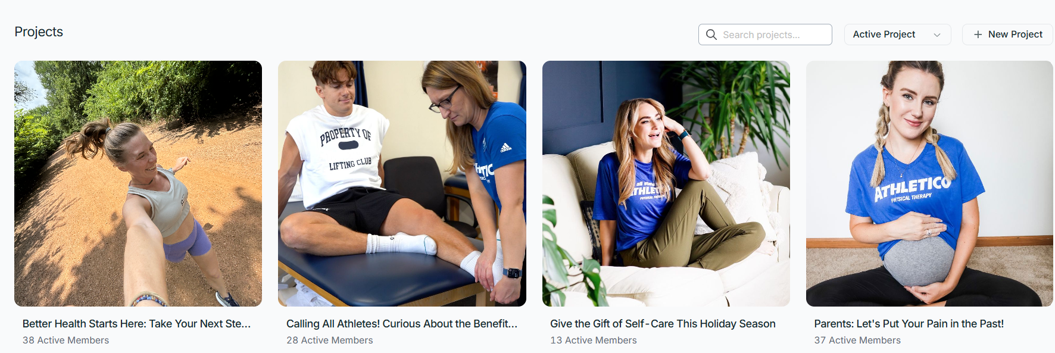
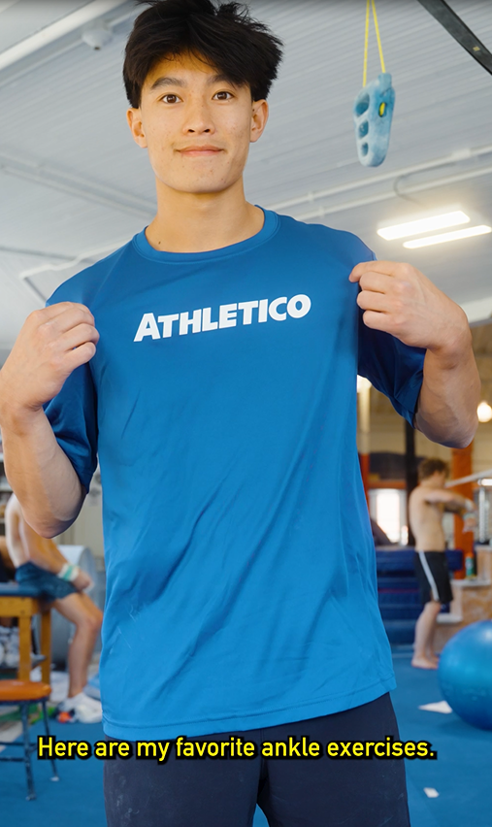
Influencer Marketing Program – Aspire
Personally sourced, vetted, and signed 30+ influencers (2024–2025) across priority markets
Owned end-to-end influencer relationships, including negotiation, contracts, and communication
Created and managed affiliate links; reviewed content for compliance and brand standards
Tracked performance, conversions, and insights; delivered executive-facing campaign recaps (Example shown on slide 9)

Slide 8
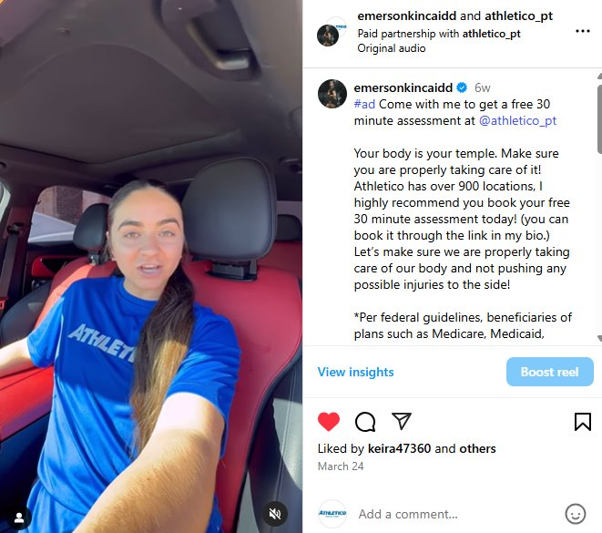
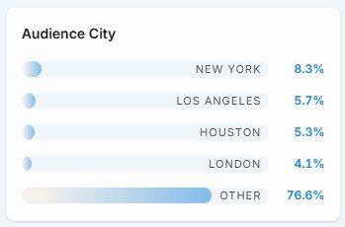
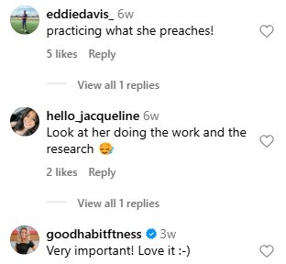
Influencer Campaign Recap Example
(Influencer Marketing Program)
Creator | Clinic | Content | Reach | Impressions | Link Clicks/Leads | Likes | Comments/Sentiment | Saves | Engagement
Emerson Kincaid | Flower Mound, TX | 1 IG Reel, 1 IG Story, 1 TikTok, 1 YouTube Short | 50,242 (TikTok not included) | 91,370 | 446 / 4 | 1,338 | 15 / Positive | 31 | 1,374
Sentiment
Audience
Campaign Performance:
Emerson shared 4 pieces of content, reaching thousands of viewers and generating 15 shares and 31 saves—a strong indicator of intent to revisit and potential conversion.
Based in Texas, a key priority market, her content helped us reach a highly relevant regional audience while maintaining strong engagement at scale.
In addition to completing a free assessment herself, Emerson drove 3 leads making this a strong-performing campaign and a partnership we’d pursue again.
IG Reel
*Meta API doesn't support IG story metrics
⭐ We partnered with Emerson, a fitness creator with 300K+ Instagram followers, whose gym-based content made conversations around injury prevention and addressing aches and pains feel like a natural fit.
Notes:
Social Reach = total number of unique users who have seen or interacted with your social content; indicating the potential audience size of your content
Impressions = total number of times your content has been displayed to users on social media platforms
Saves = user saved this piece of content to refer to it at a later date. We consider this purchase intent.
Engagement = interactions
About This Creator
Emerson is a fitness creator who shares workouts and fitness tips with her audience. She has a high following and a very engaged audience who look to her for advice on training and injury prevention.
How was this clinic selected?
Creator preference/location

Slide 9
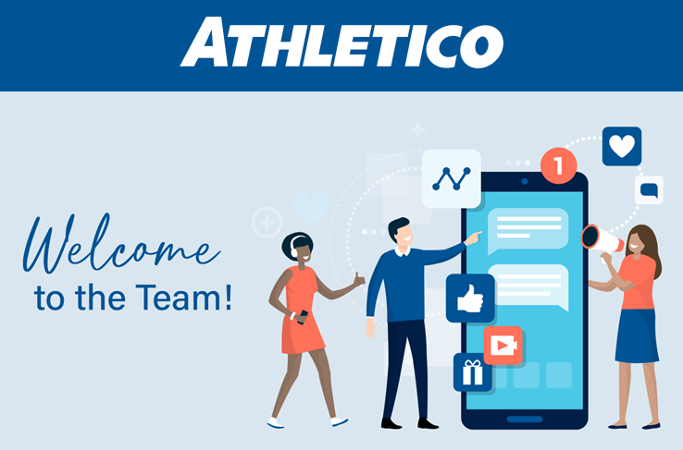
Social Ambassador Program (2024–2026)
Problem: Growing demand for short-form video without agency spend
Approach: Built and scaled a paid internal creator program with clear guidance and approvals
Impact: Scaled short-form video production while maintaining brand quality; fueled YoY growth and YouTube Shorts expansion

Slide 10
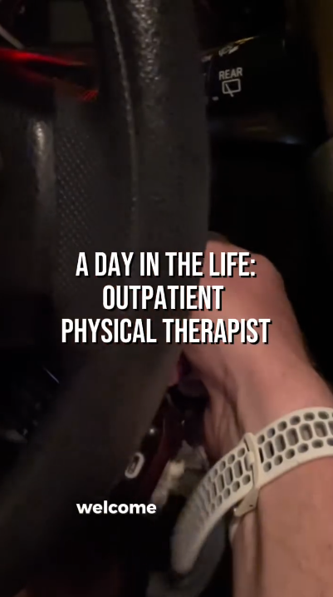
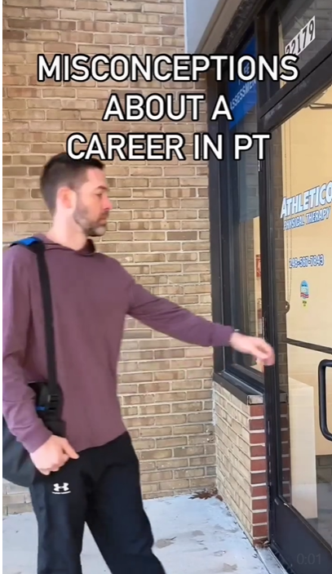
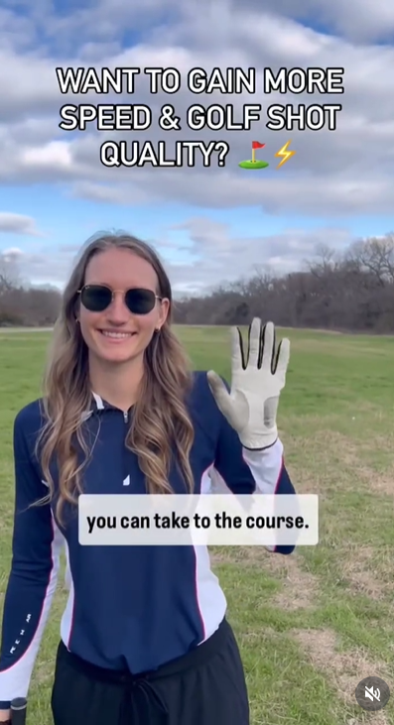
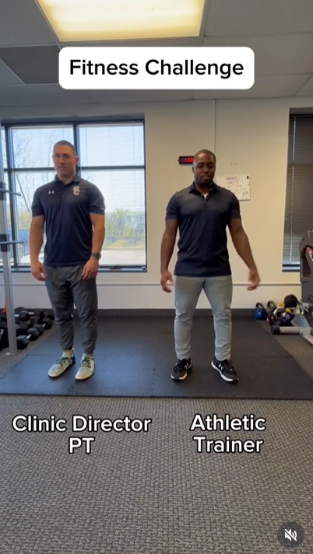
Employee-Generated Content (Social Ambassador Program)
Built and ran a paid internal creator program that empowered employees to produce on-brand, high-quality short-form video
Guided topics, reviewed content, and approved posts to align with brand and business goals
Drove above-average shares
Supported PT student recruitment goals
Repurposed blog content
Created to drive shares & expand audience reach

Slide 11
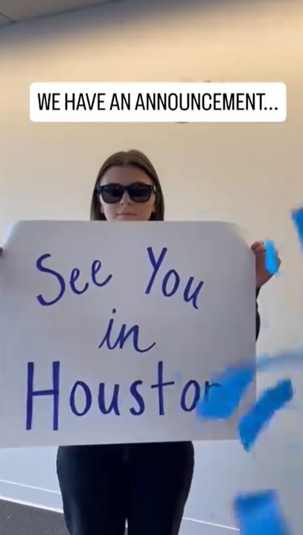
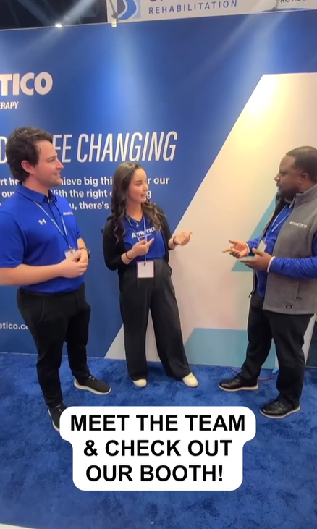
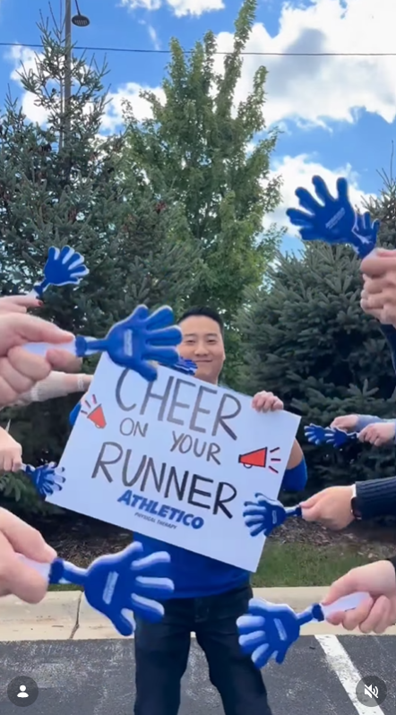
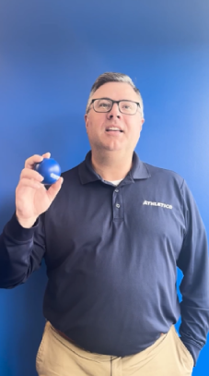
Direction/Script Writing
Led short-form video creation across campaigns—directing production, writing scripts, and developing concepts through final edit.
Directed, drove shares for announcement
Filmed & edited
Used trend to boost reach
Wrote script, led direction

Slide 12
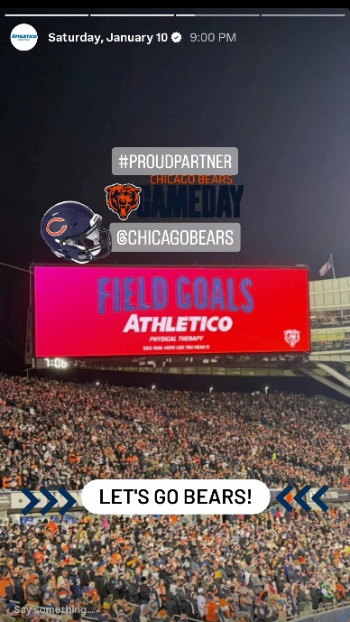
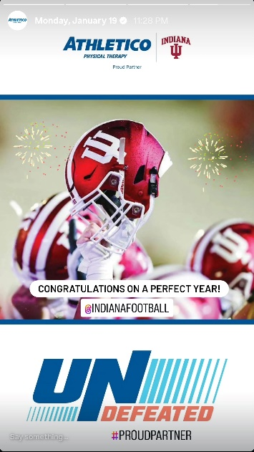
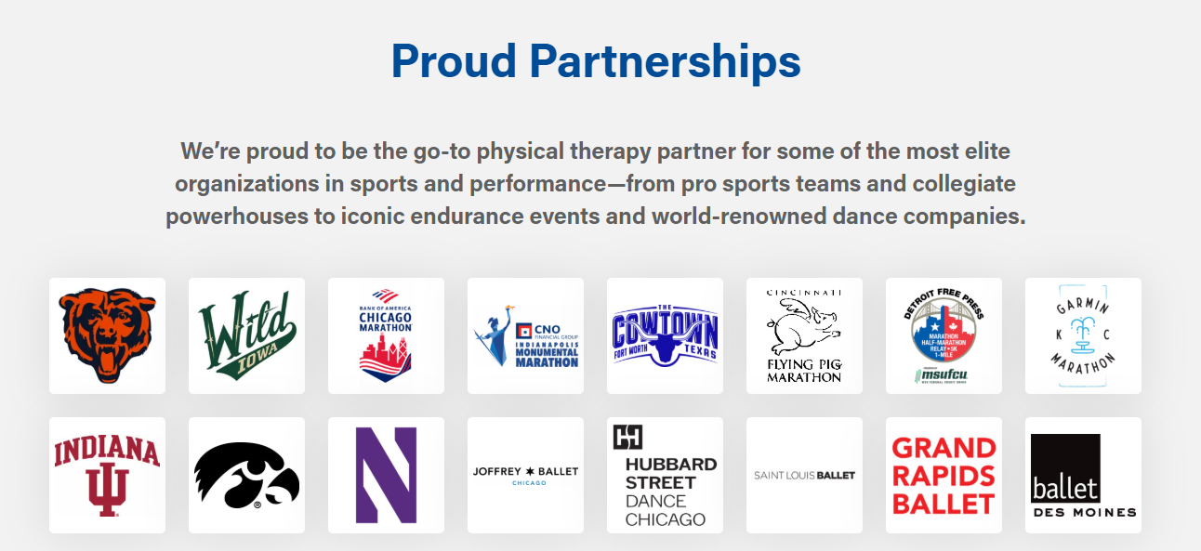
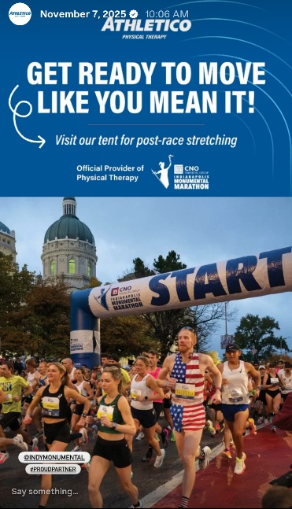
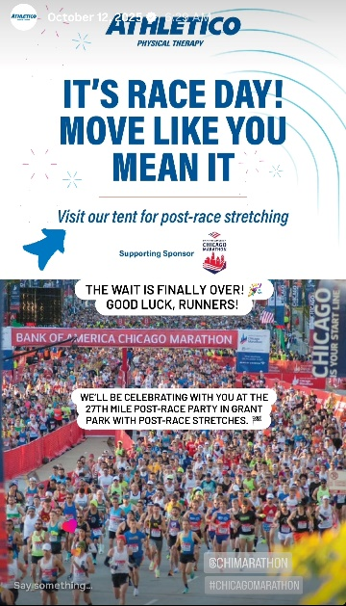
Partnership Social Content
Guided partnership social content with creative direction and concepts
Collaborated across teams with shot lists and examples
Led vision for projects like the Joffrey Ballet Collab
Notes:
https://www.facebook.com/athleticopt/
https://www.instagram.com/athletico_pt/
https://www.linkedin.com/company/athletico
https://www.pinterest.com/athletico_pt/
https://www.tiktok.com/@athletico_pt
https://x.com/Athletico
https://www.youtube.com/@AthleticoPT
https://www.strava.com/clubs/athleticopt

Slide 13
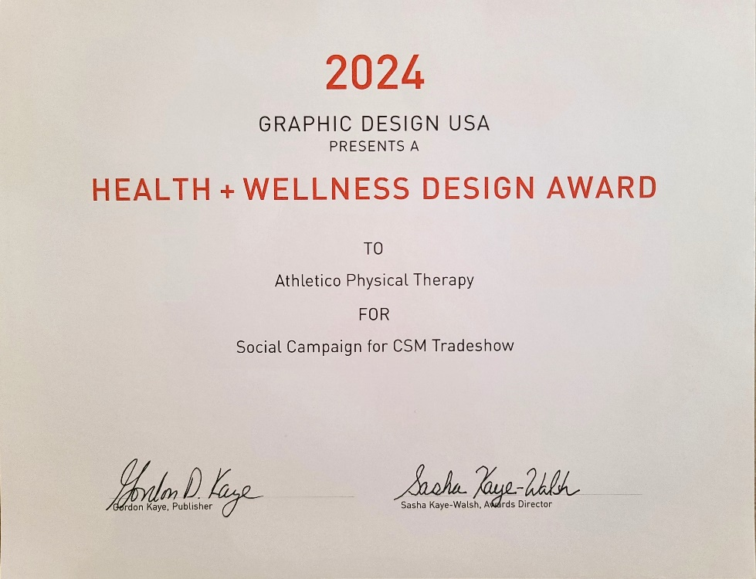
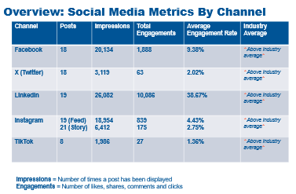
Campaign Recaps
Shared executive-facing campaign recaps with performance insights and recommendations to inform future strategy.
APTA – Combined Sections Meeting (Largest Event)
2024: Award for the social content
2025: Led strategy, execution, onsite video & photos

Slide 14
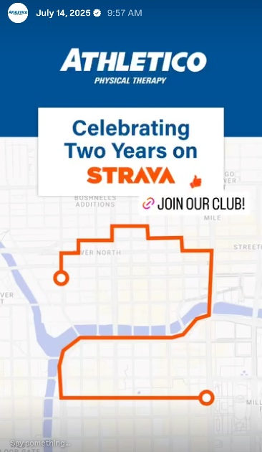
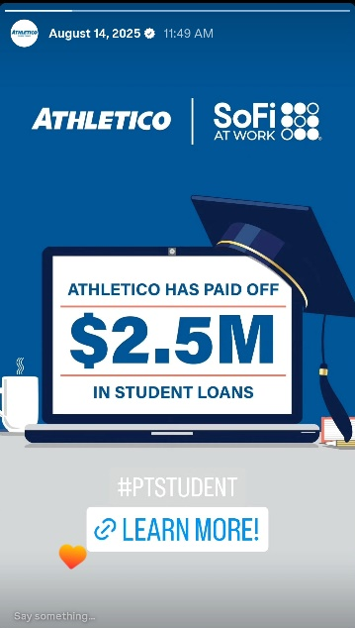
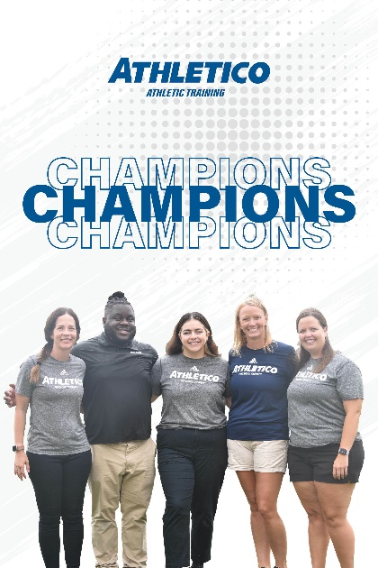
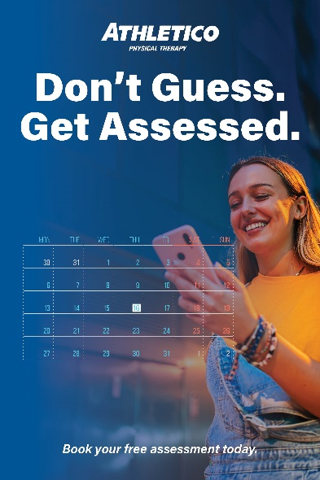
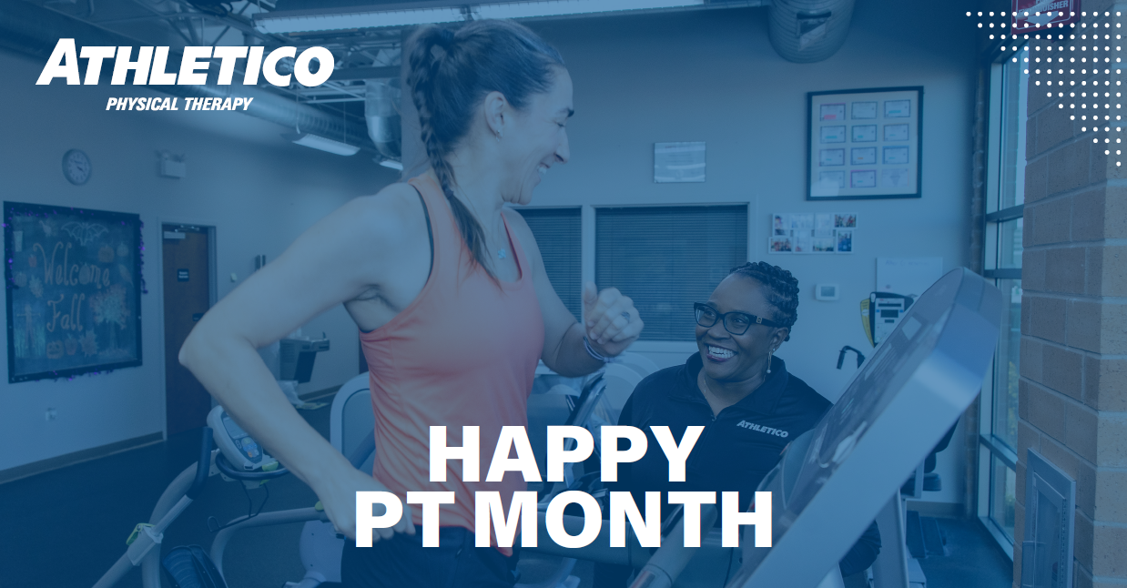
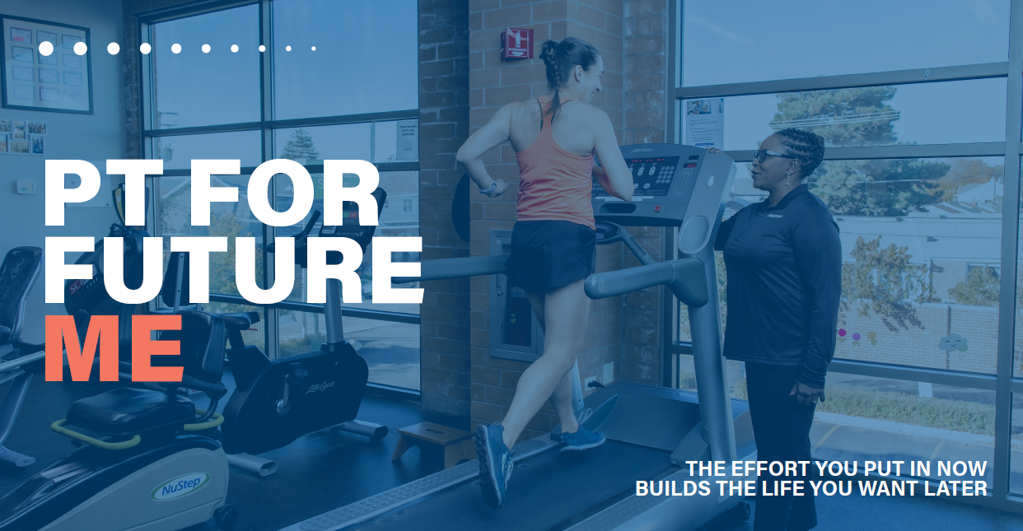
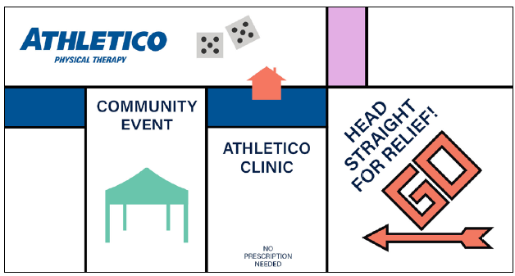
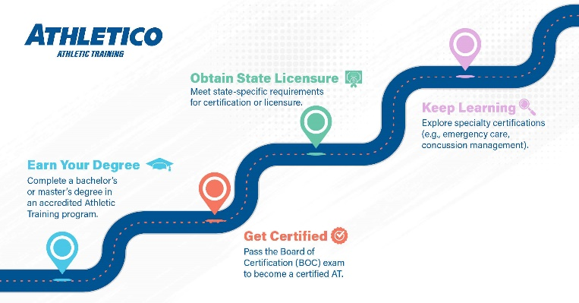


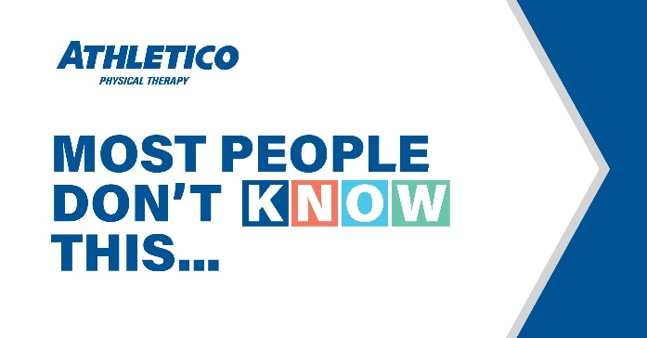
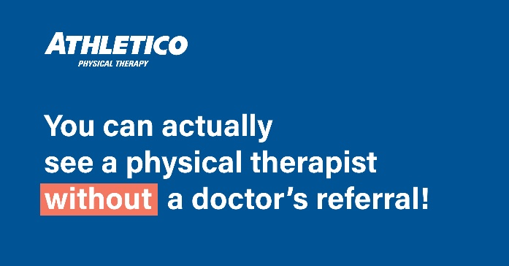
Graphic Design Team
Partnered closely with the graphic design team on social projects and initiatives
Led ideation, brainstorming, and monthly check-ins with three designers
Owned copywriting, creative direction, and project prioritization

Slide 15
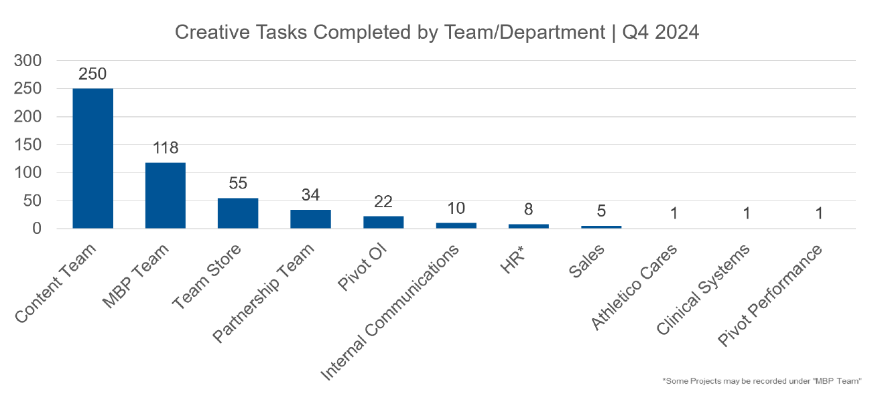
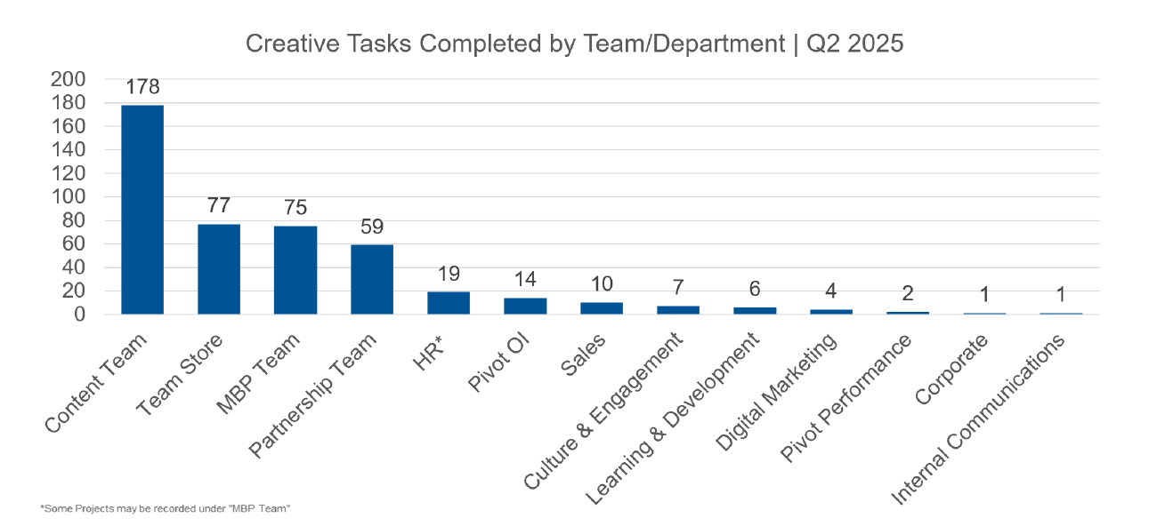
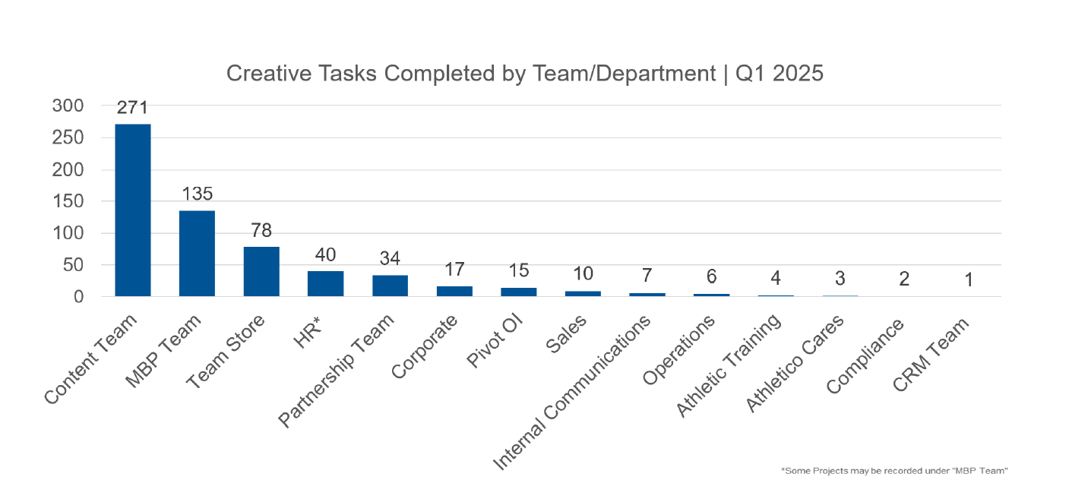
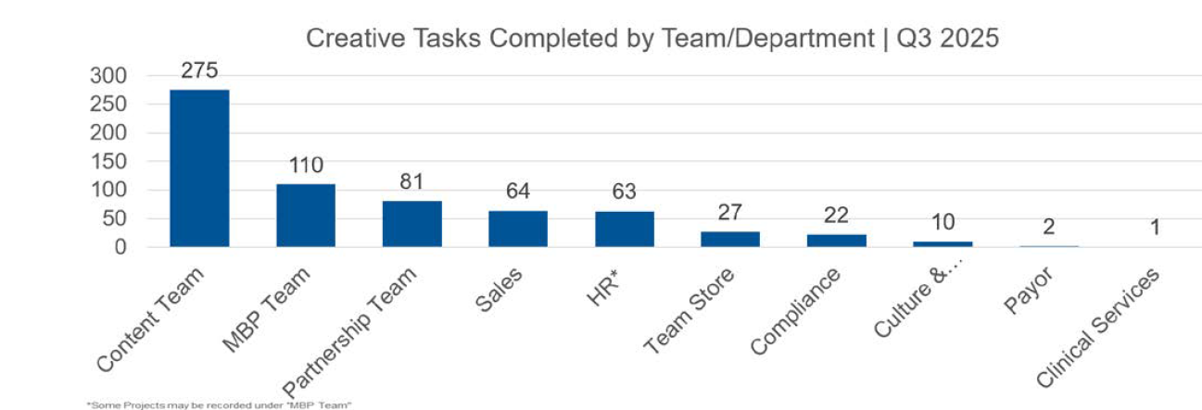
Content Per Quarter
Oversaw ~250 assets per month using Teamwork.com to manage workflows and approvals.

Slide 16
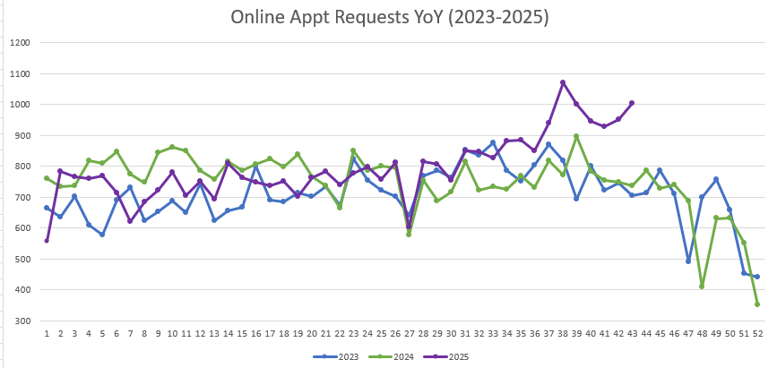
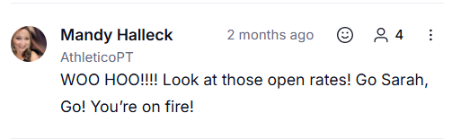
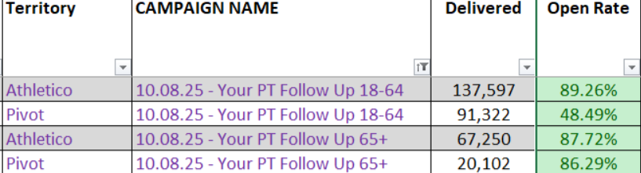
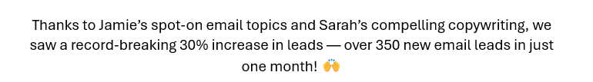
Lead Copywriter – Email Marketing
Crafted compelling email copy that aligned with brand tone and campaign objectives — including multiple record-breaking emails for leads and open rates.
Notes:
https://www.facebook.com/athleticopt/
https://www.instagram.com/athletico_pt/
https://www.linkedin.com/company/athletico
https://www.pinterest.com/athletico_pt/
https://www.tiktok.com/@athletico_pt
https://x.com/Athletico
https://www.youtube.com/@AthleticoPT
https://www.strava.com/clubs/athleticopt

Slide 17
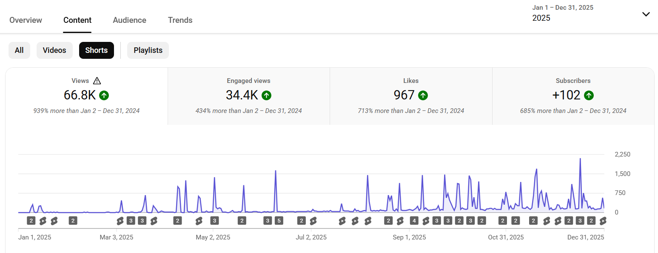
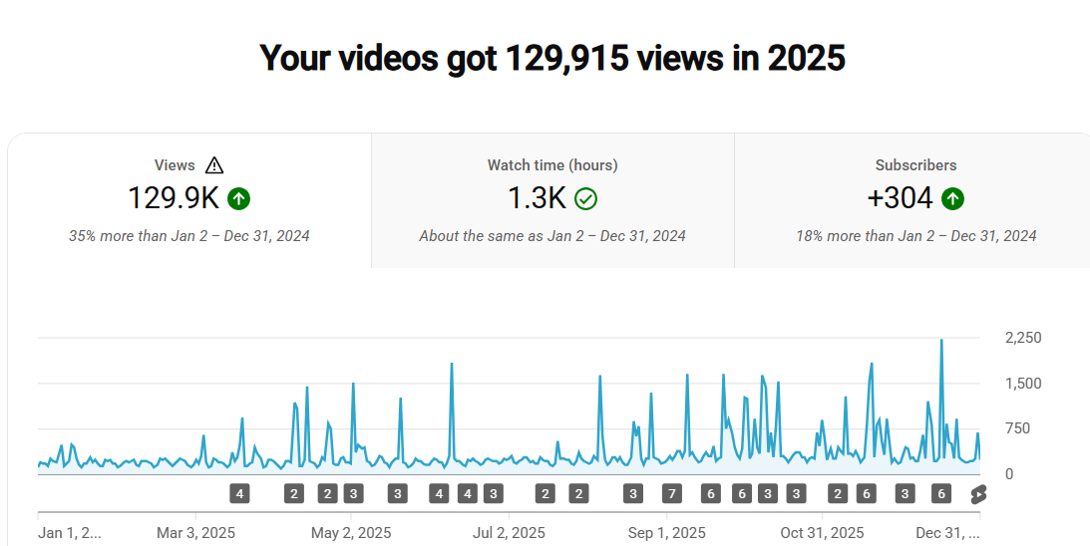

YouTube Growth
Doubled video views from 2024 → 2025 by scaling Shorts from 15 → 73
6.4K in 2024 vs. 66.8K views in 2025, powered by the Social Ambassador Program and short-form content strategy.
Notes:
https://www.facebook.com/athleticopt/
https://www.instagram.com/athletico_pt/
https://www.linkedin.com/company/athletico
https://www.pinterest.com/athletico_pt/
https://www.tiktok.com/@athletico_pt
https://x.com/Athletico
https://www.youtube.com/@AthleticoPT
https://www.strava.com/clubs/athleticopt

Slide 18





Pivot Acquisition: 250+ Clinics | 25K+ Followers
Guided content strategy and execution through the Pivot acquisition and transition.
Balanced multiple priorities while learning Athletico’s programs and systems, improving Athletico systems.
Managed a major content shift, ensuring a consistent presence, strong engagement, and quality across channels.

Slide 19








Pivot Physical Therapy: 2020–2023
I was hired in March 2020 as a Social Media Specialist, right before the pandemic hit. I was tasked with producing video content and increasing output to meet the growing demand, helping Pivot stay connected with patients when it mattered most.

Slide 20






Pivot Health Solutions
Created video and social content for all Pivot Branches 2020-2024:
Pivot Onsite Innovations (acquired by Concentra, 2025)
Pivot Occupational Health (closed, 2023)
Pivot Performance (Shutdown / merged with Athletico, Feb 2024)
Supported filming, editing, and posting across all branches during transition periods.

Slide 21



Feedback
View Recommendations on LinkedIn.

Slide 22



Thanks For Your Time
Sarah Taylor Mosholder
443-613-9448
sarahtaylor1515@gmail.com
Connect with me on LinkedIn

